Slide 1
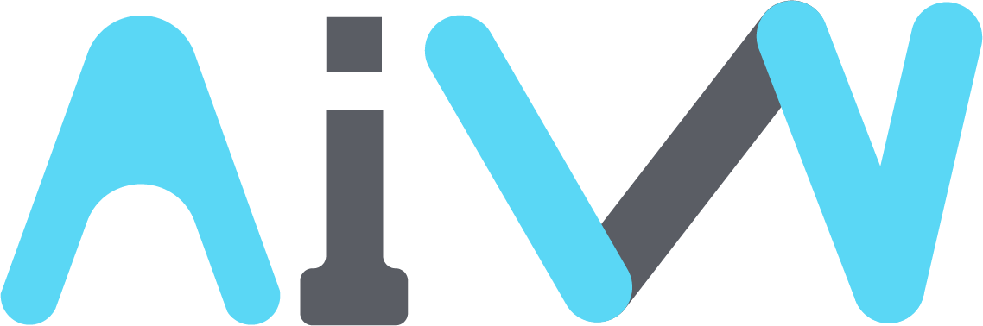

WHITEPAPER
AI WEALTH PROJECT
Web 3.0 based M&A Platform Ver. 0.1 (2025)

Slide 2
00 | Table of Contents
Table of Contents
Overview
02
Token Economy
17
Overview
AIW Token Value Support Mechanism/Logic/
Structure
AIW Token Burning Policy
AIW Token Dividend Policy
Token Economy
Background
02
Roadmap
22
Growth of the M&A Market
Transformation of the M&A Market into a Platform
Characteristics of Blockchain Technology
Recent Trends in Blockchain Technology
Case Studies: Blockchain Applications in the M&A Industry
Problem Awareness
06
Visions of M&A Platform
23
Information Asymmetry in M&A
Accessibility in M&A Transactions
Inefficiencies Among Transaction Participants
Conclusion
Solution
10
Disclaimer
24
Overview
M&A Research Activity
M&A DAO Fund
M&A Process & Roles
AI Program
Application of AI-Based Decision-Making Models
Multi-Layer Token Economics
References
26

Slide 3

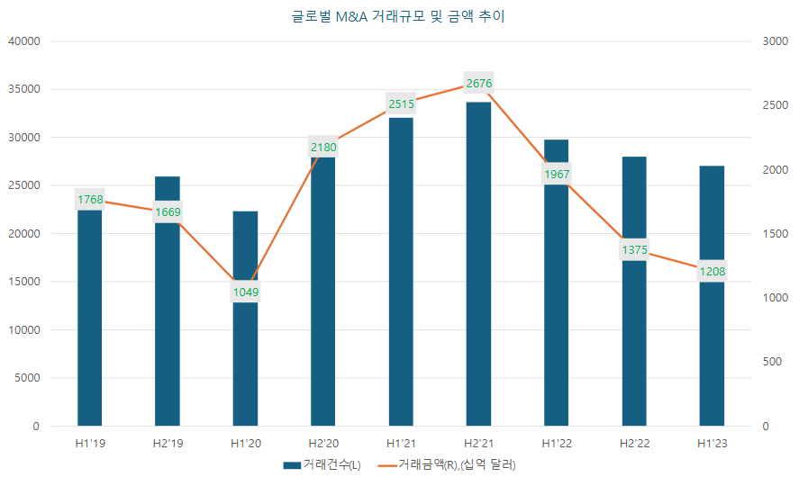
AI WEALTH Project
Web 3.0 based M&A Platform
01 | Overview
The AI-RICCO platform adopts blockchain technology, particularly DAO (Decentralized Autonomous Organization), to enhance transparency and efficiency in the M&A process, allowing broad public participation. By utilizing AI technology, AI-RICCO helps companies execute M&A more efficiently and increase success rates. Through the DAO FUND, multiple M&A transactions involving both listed and private companies will be conducted, with AIW tokens serving as both governance and utility tokens.
The AIW token follows a value-expanding structure. As M&A activities progress, AIW tokens are used for funding, and the Vesting Delay Period helps control circulation and reduce market impact. Additionally, acquired companies issue tokens, and an AIW token buyback system is implemented based on valuation. Moreover, as a utility token, AIW provides membership benefits in digital asset exchanges, and these privileges extend to newly acquired companies.
The AI-RICCO platform also focuses on information transparency, a key issue in traditional M&A markets. It introduces a DAO-based reward system to incentivize the acquisition and verification of M&A information, promoting engagement from specialized research agencies.
This system supports the popularization of M&A as an alternative investment. In the long term, AI-RICCO aims to expand beyond stocks and equity to real estate and intellectual property, evolving into an STO platform.
Overview
02 | Background
1. Growth of the M&A Market
Background
The M&A market is steadily expanding. In 2021, immediately following COVID-19, the global M&A transaction volume reached 66,000 deals, with a total transaction value of $5.2 trillion, marking an all-time high. This represents a 30% year-over-year increase in the number of transactions and a 61% increase in total deal value. In the first half of 2023, there were 12,000 deals amounting to $2.7 trillion, showing a continued rise in transaction value compared to pre-COVID levels. This market growth has led to a surge in public interest in M&A, with platforms such as Axial, which facilitates M&A participation for private companies in the U.S., operating for over a decade.

Slide 4
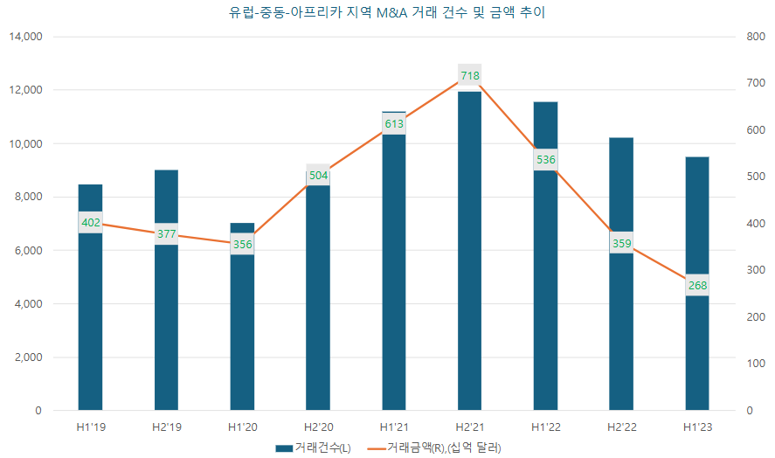
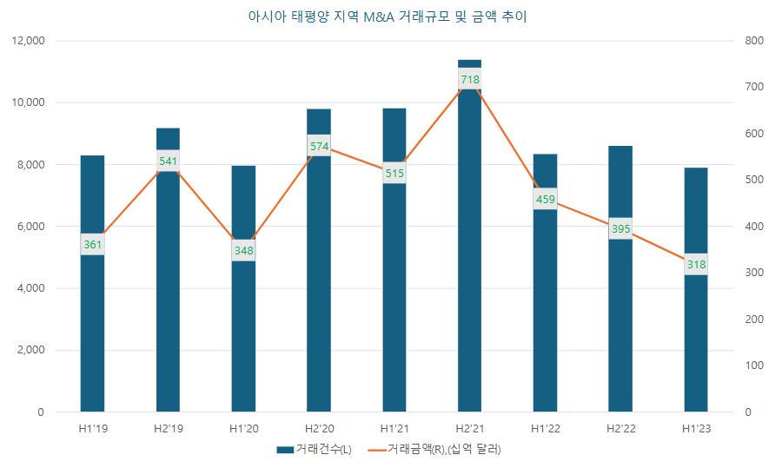
AI WEALTH Project
Web 3.0 based M&A Platform
The global M&A market saw significant growth in 2021, with Europe experiencing a 45% increase in transaction volume and a 55% increase in deal value in 2021, reaching 23,110 deals and $1.3 trillion. In the Asia-Pacific region, M&A activities were heavily driven by fintech, with total transactions growing 19.3%, from 17,745 deals in 2020 to 21,169 in 2021. The total deal value also rose 33.7%, from $0.9 trillion in 2020 to $1.2 trillion in 2021. Similar growth trends have been observed in Europe, the Middle East, Africa, and Asia-Pacific, with M&A deal values in the first half of 2023 significantly exceeding pre-COVID levels.
[M&A Market Growth Trends in Europe: 2017 - 2021]
The M&A market is expected to maintain its growth trajectory in the coming years. Post-COVID, the global supply chain restructuring has accelerated, pushing market players to adopt increasingly aggressive M&A strategies to expand market share.
In line with this global growth trend, most corporate CEOs are actively pursuing investment and M&A as key growth strategies. The 2021 global M&A market set record highs in both transaction volume and deal value, reflecting this aggressive push.
This surge in M&A activity has drawn not only M&A professionals but also the general public into the market. As a result, accessible M&A platforms have emerged, experiencing rapid growth. A notable example is Axial (https://www.axial.net), founded in New York in 2010, which enables individuals and private companies to engage in M&A deals more easily.

Slide 5
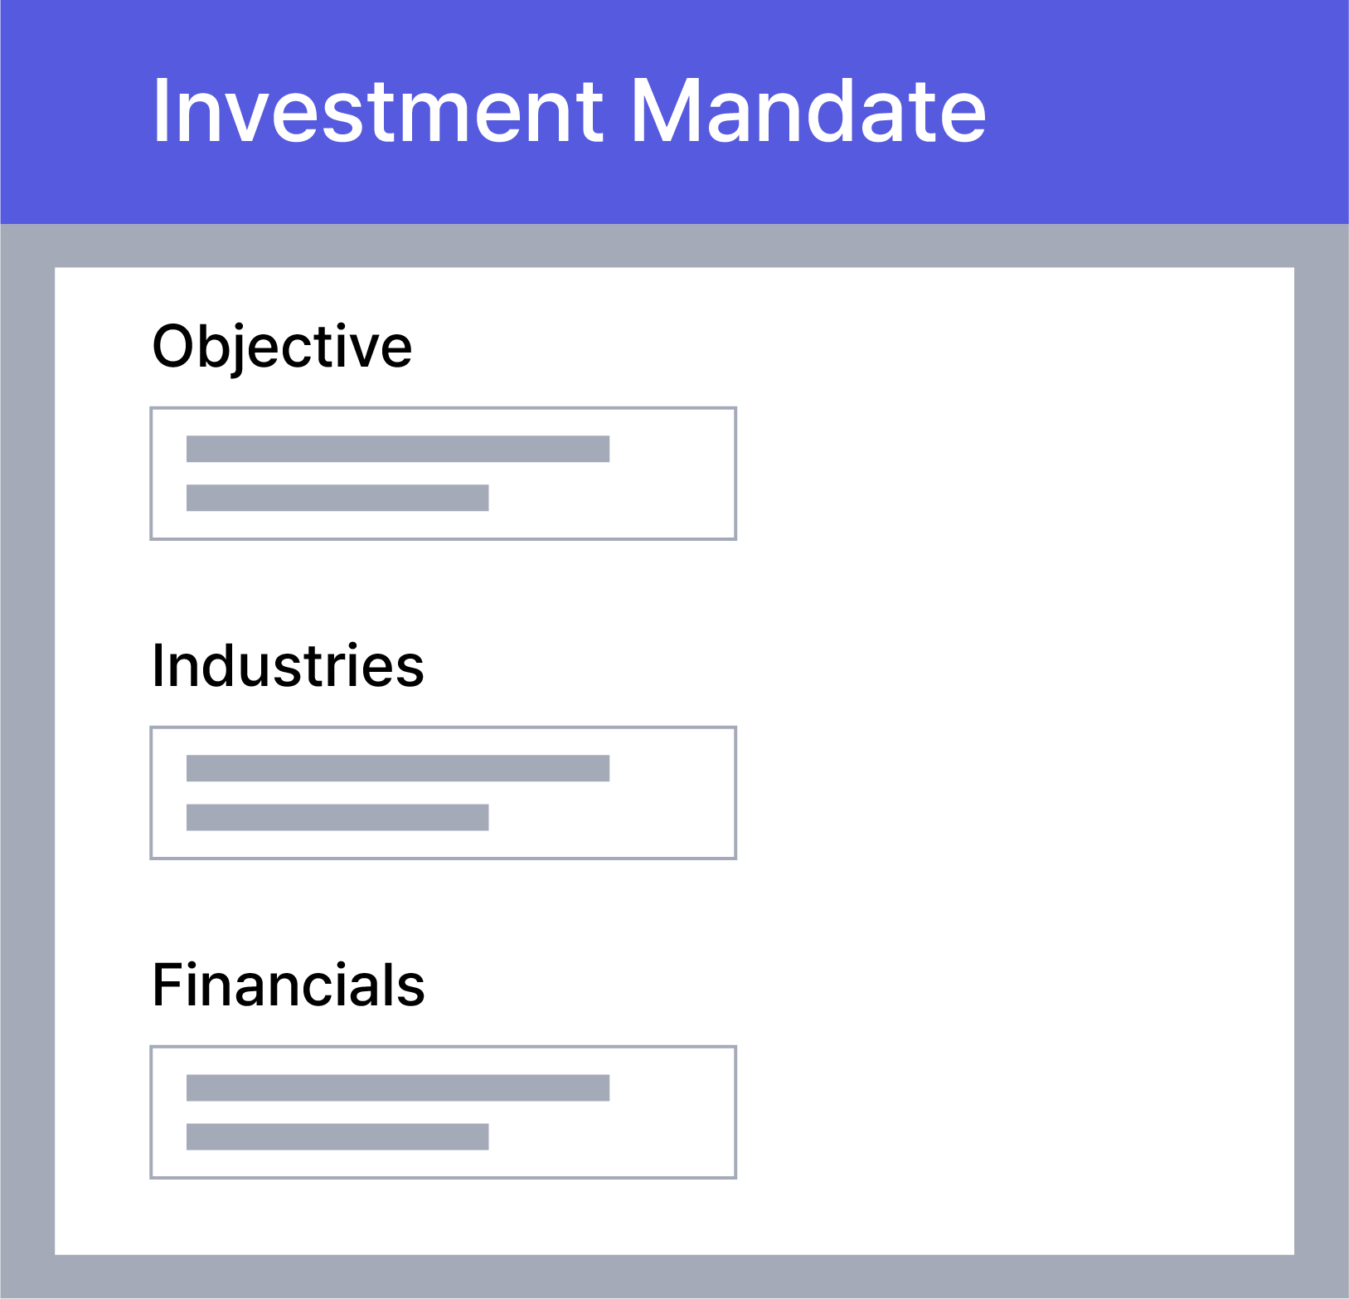
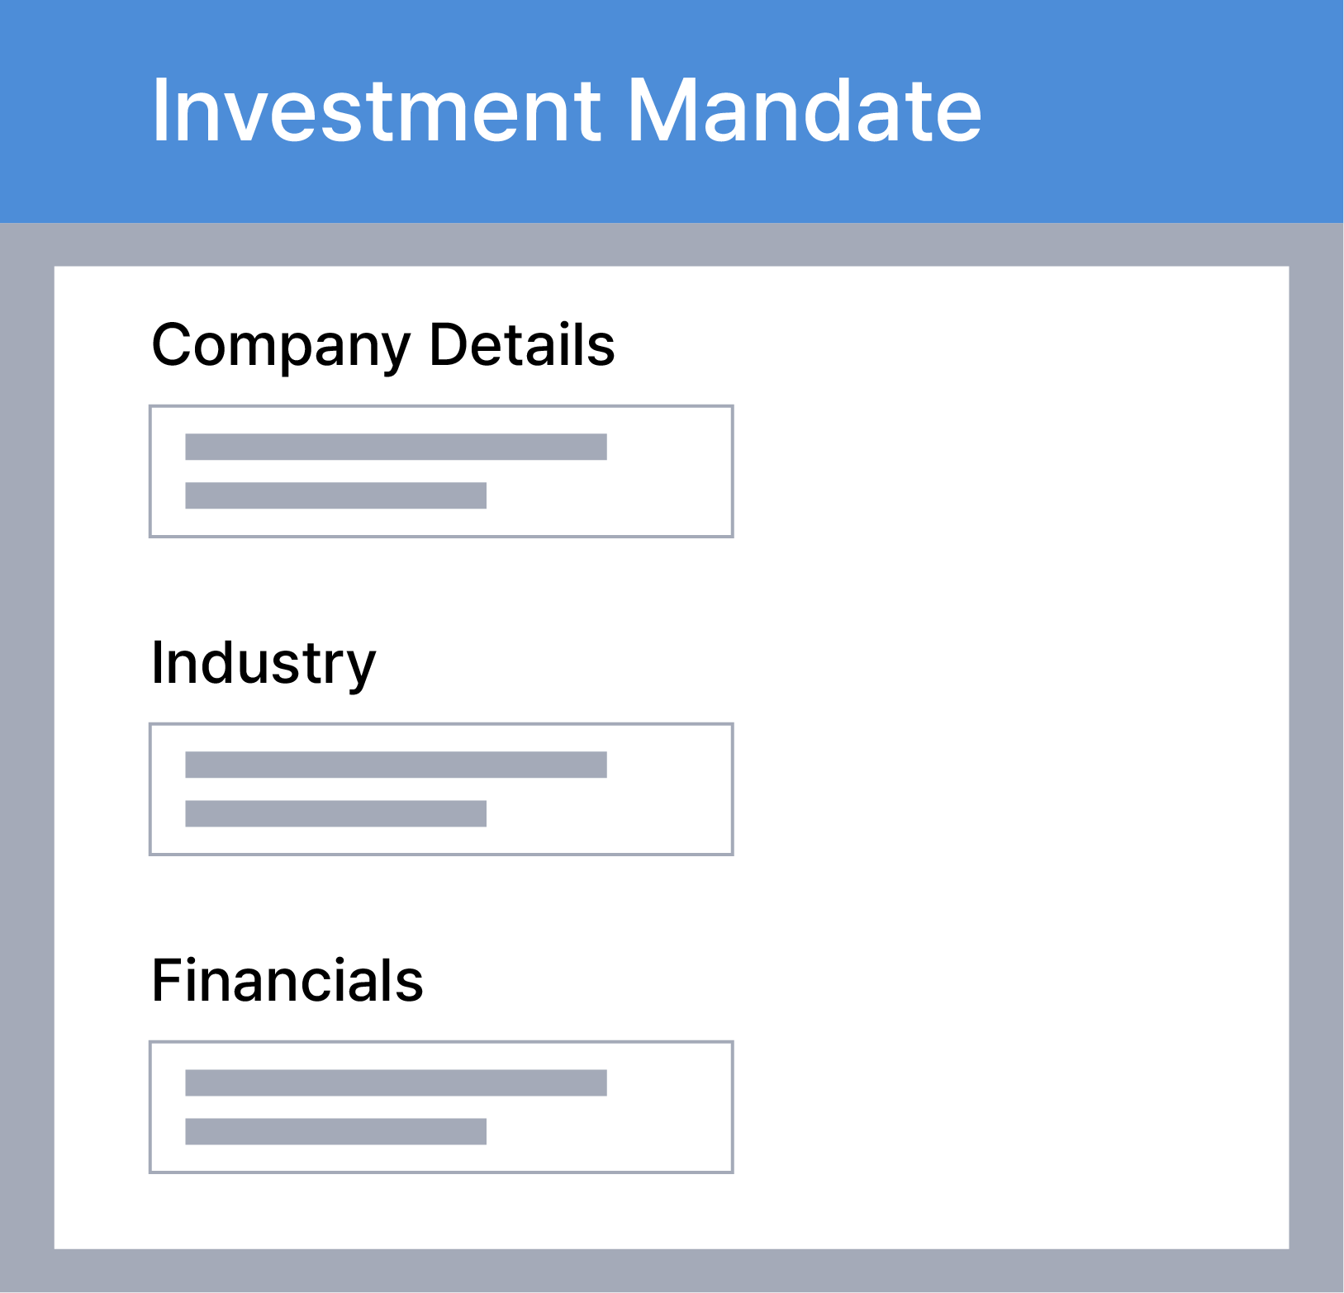
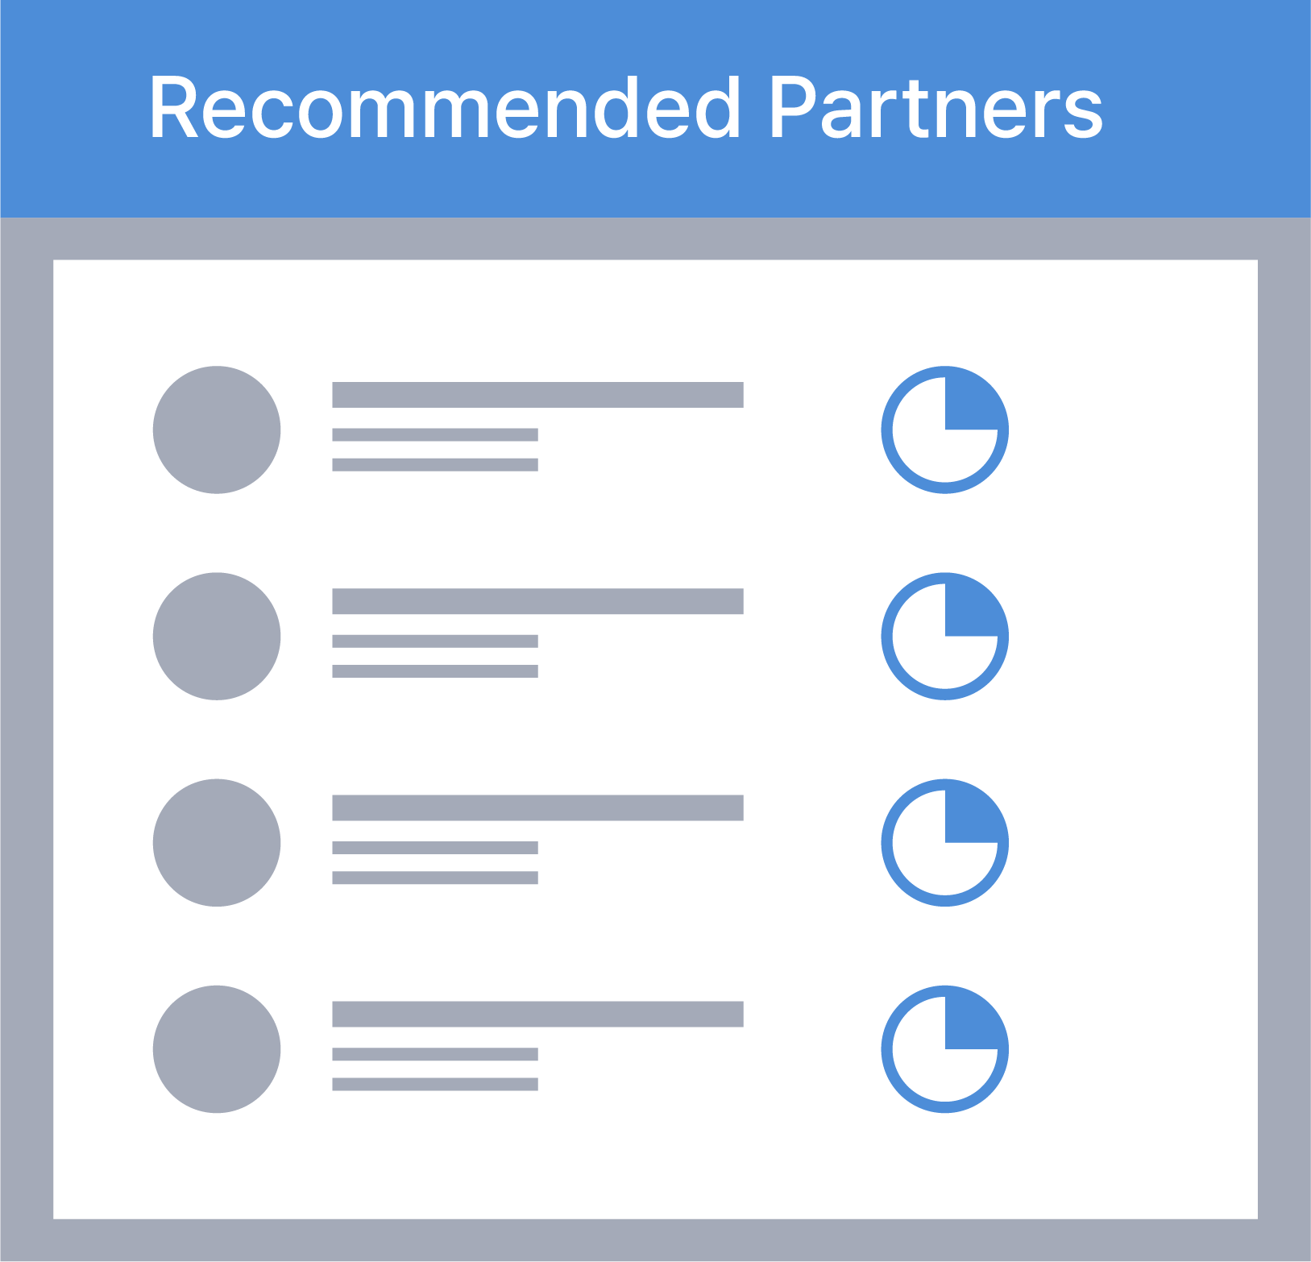


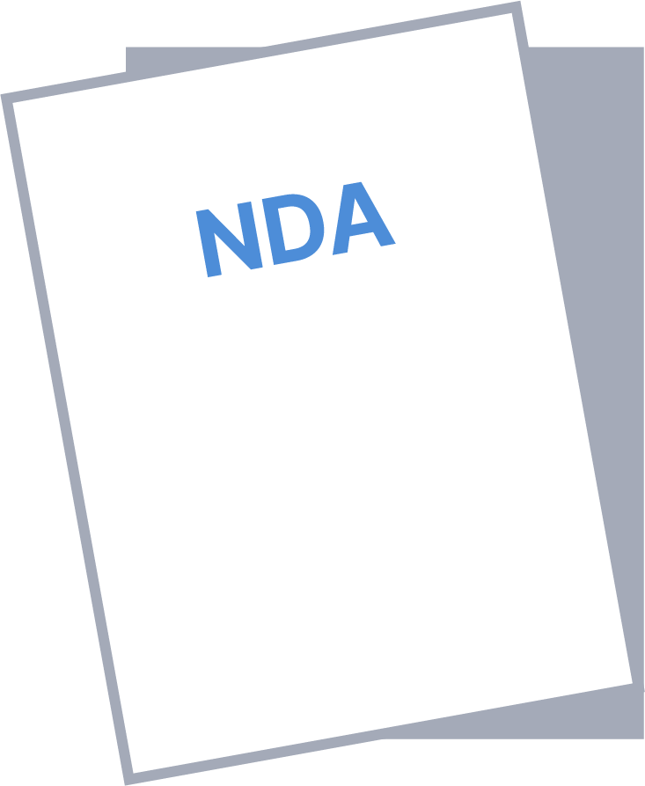
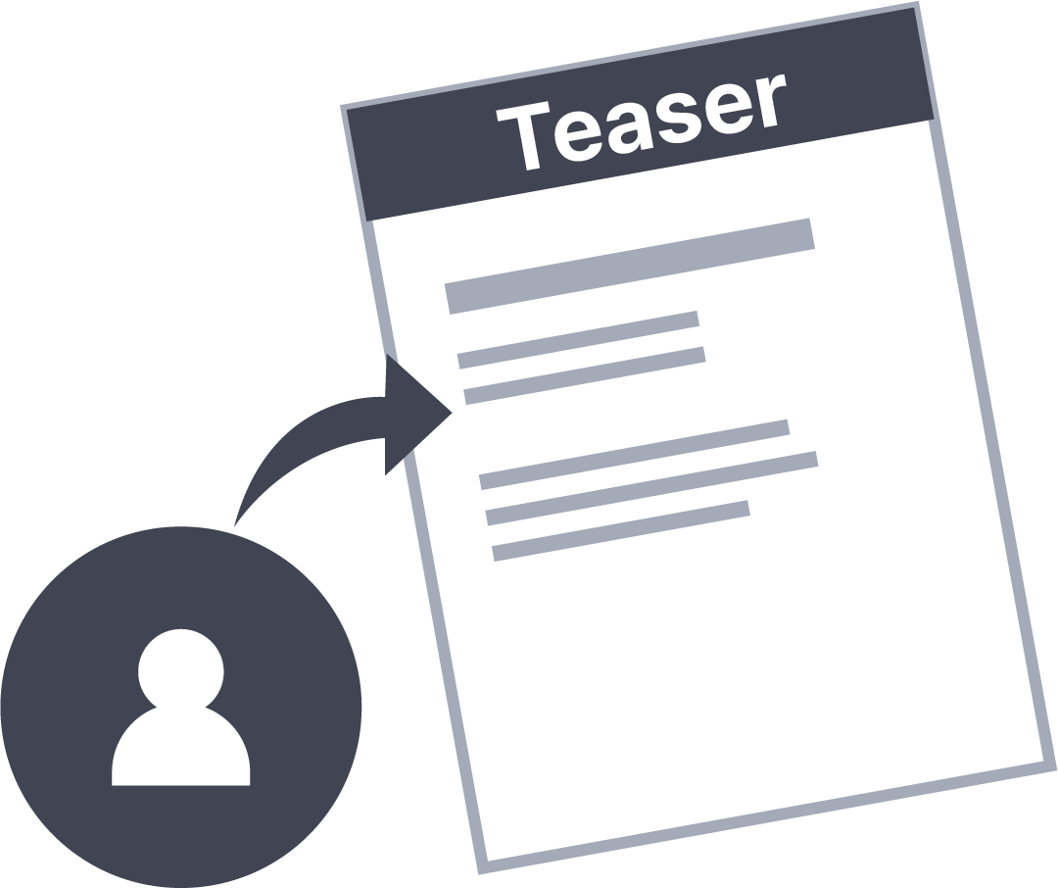
AI WEALTH Project
Web 3.0 based M&A Platform
2. Transformation of the M&A Market into a Platform
In the traditional M&A market, only direct participants, consulting firms, or expert groups could engage in the process, making it inaccessible to the general public. Most people could only learn about deals through media reports. M&A transactions were typically private business dealings between large corporations and major capital investors. With the growth of the internet and platform industries, public participation in M&A became possible. In the U.S., the concept of the Private Market Network emerged in 2012, enabling private equity trading. Axial was the first to recognize this trend, successfully transforming M&A into a platform through an automated brokerage system, securing a leading position in the market.
[Axial Platform M&A Brokerage Process]
1
2
3
Buyers (companies/investors) enter investment criteria into the Axial system
Sellers (companies) input their business information into the Axial system
The Axial algorithm matches buyers and sellers based on optimal criteria
6
6
5
4
Negotiations take place between the buyer and seller
The seller uploads a Confidential Information Memorandum (CIM), which buyers can download
The seller signs a Non-Disclosure Agreement (NDA)
The seller drafts a brief term sheet for interested buyers
Founded in 2010, Axial utilizes an online platform to broker M&A transactions for private small and mid-sized companies (middle market). It connects buyers and sellers through an algorithm-based system without banker involvement. For example, an investor on Axial can register, enter investment criteria, and receive acquisition opportunities within an average of four hours. Within eight years, Axial facilitated over 2,000 deals and brokered more than $25 billion, becoming the world’s largest online private company investment network.
Axial’s case shows how technological advancements have enabled entry into previously unprofitable and inaccessible markets. It highlights the impact of fintech on traditional financial markets, where AI, messaging services, and other technologies are expanding their applications.

Slide 6
AI WEALTH Project
Web 3.0 based M&A Platform
Following this trend, professional investment banks (IBs) such as Qatalys and Centerview are also working to transforming M&A into a platform by partnering with tech-driven startups.
Among these integrated technologies, blockchain is gaining significant attention. It enables the creation of independent financial markets through tokenization while also integrating with traditional financial markets, expanding their scope and influence.
3. Characteristics of Blockchain Technology
Blockchain technology is regarded as a suitable solution for M&A due to three key characteristics: transparency, convenience, and cost reduction by eliminating intermediaries. First, transparency is a major reason blockchain has gained attention. Blockchain enhances financial transparency by making transactions, issuances, and capital flows publicly accessible. Second, convenience comes from easy access via wallets, enabling individuals and regions previously excluded from traditional financial systems to use blockchain-based services more easily. Third, blockchain reduces the need for intermediaries. In traditional finance, banks and service providers generate revenue through transaction fees. In contrast, a fully decentralized blockchain system operates without intermediaries, lowering costs and increasing efficiency.
Blockchain’s characteristics make it a strong fit for M&A applications. Transparency in traditional M&A transactions has been limited, restricting public access to information. However, blockchain-based transactions, DAOs, and incentive structures can enhance public accessibility to M&A activities. Additionally, while traditional M&A markets have high entry barriers, blockchain-based services can broaden shareholder participation and make M&A more inclusive.
4. Recent Trends in Blockchain Technology
Blockchain technology has continuously expanded, introducing new concepts such as DeFi and NFTs. More recently, Web 3.0 has emerged as a key term, presenting a new vision for decentralized web services worldwide. While some critics argue that Web 3.0 lacks concrete implementation and is primarily a marketing term, others view blockchain as a transformative technology capable of disrupting the centralized Web 2.0 structure.
The core idea of Web 3.0 revolves around data ownership, which is expected to be addressed through blockchain-powered decentralized ledgers. A crucial component of this 'personalized web' is DAO (Decentralized Autonomous Organization), where users holding tokens or NFTs can vote and actively participate in platform governance based on their ownership stake.

Slide 7
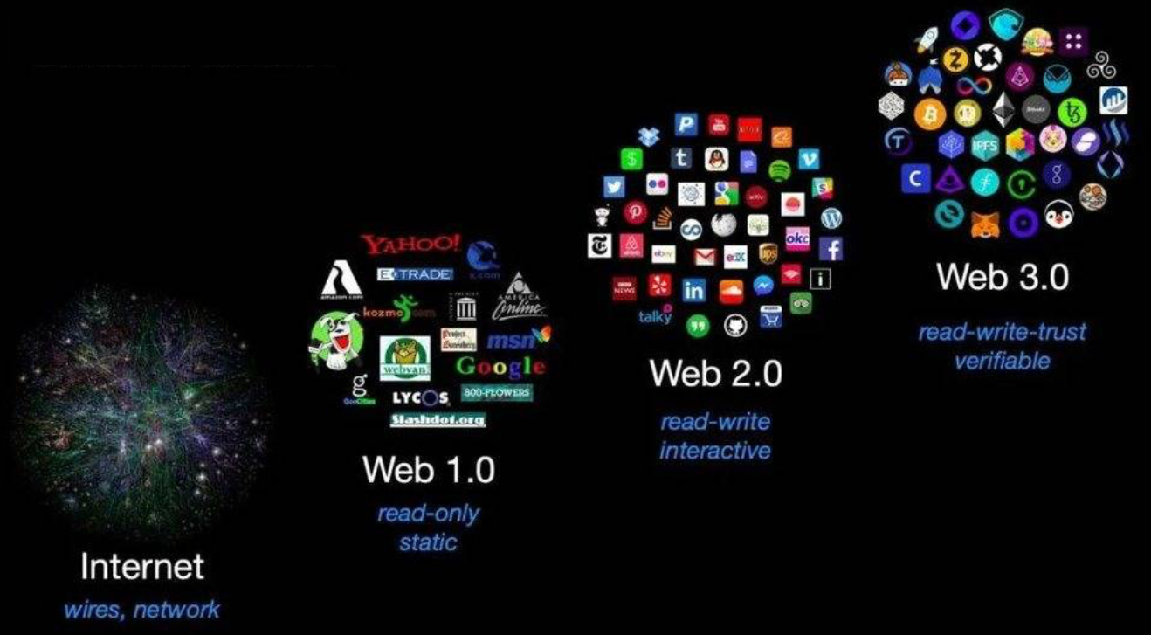
AI WEALTH Project
Web 3.0 based M&A Platform
[Evolution Toward Web 3.0]
Despite ongoing debates, Web 3.0 and DAO advancements are expected to lead to a more democratic online network. DAOs, in particular, are being explored as an alternative organizational structure for the future. The ability to own and exercise governance rights through token holdings presents an attractive operational model. The AI-RICCO platform aims to integrate this democratic governance process into M&A, enhancing transparency and participation in corporate acquisitions.
5. Case Studies: Blockchain Applications in the M&A Industry
The M&A industry is integrating AI and blockchain to enhance accessibility. Blockchain’s ability to create independent financial ecosystems makes it a natural fit for M&A.
One of the first projects to introduce blockchain-based M&A services is GMAP, which aims to facilitate private company M&A through a blockchain database and token economy. Internationally, the Acquier-Fi project is also working on building a blockchain-based M&A platform. These initiatives leverage blockchain’s key features to enhance broker rights, reduce fees, and introduce additional services through token economies, with the ultimate goal of expanding into a broader financial platform beyond M&A.
Although both projects are still in their early stages, they serve as meaningful indicators that industry players recognize blockchain’s potential in M&A and are actively exploring its applications. As a result, the number of market entrants developing blockchain-based M&A platforms is expected to grow further.

Slide 8
AI WEALTH Project
Web 3.0 based M&A Platform
03 | Problem Awareness
The integration of blockchain technology in M&A is expected to be highly relevant due to the following reasons. First, information asymmetry in the M&A market. Second, inefficiencies that arise between transaction parties. Third, limited accessibility to the M&A market. Fourth, lack of transaction standardization.
The M&A process generally consists of preparation, analysis, approach, due diligence, contract/acquisition, and merger. At each stage, issues such as information asymmetry, accessibility barriers, inefficiencies, and lack of standardization are commonly observed. Since M&A transactions involve multiple players, including investment banks, consulting and advisory firms, legal and accounting firms, the process is highly complex and often incurs significant costs and complications along the way.
Problem Awareness
[M&A Process Stages]
PREPARATION
IMPLEMENTATION
Launch
Analysis
Contact
Due Diligence
Completion
Post-Merger
Kick-off and
Strategy
Market Analysis
And Research
LOI, Due Diligence,
Company Valuation
Acquisition
Integration
1. Information Asymmetry in M&A
One of the biggest challenges in M&A accessibility for the general public is information asymmetry. M&A transactions, especially those involving public companies, are often conducted privately and discreetly. Access to critical details—such as which companies seek M&A, their valuations, deal structures, and transaction sizes—is fundamentally restricted. In many cases, even corporate structures and financial statements are too complex for the general public to interpret.
To address this issue, a structured system must be established where experts and M&A players can share information transparently. Additionally, an appropriate reward mechanism should be in place to incentivize information analysis and disclosure through a platform-based approach. Information asymmetry remains one of the biggest barriers to broader M&A participation.
2. Accessibility in M&A Transactions
Traditionally, the M&A market has been restricted to private equity firms, hedge funds, VCs, and investment banks. Acquiring or merging with a company is considered a high-risk investment, leading regulatory bodies to implement investor protection measures that often exclude non-accredited institutions or individuals with lower net worth from participating in such transactions. Furthermore, corporate and industry analysis requires specialized knowledge, further limiting participation for non-experts.

Slide 9
AI WEALTH Project
Web 3.0 based M&A Platform
Due to these challenges, understanding the overall M&A process and its mechanisms is crucial, along with the ability to manage fund investments and track transactions. M&A transactions involve strict regulatory, accounting, legal, contractual, and administrative requirements, making it easier for institutional investors to manage a few large capital holders rather than catering to a broad base of smaller investors. Consequently, traditional M&A markets have not prioritized accessibility for retail investors, as there has been little demand or necessity to expand participation beyond institutional players.
3. Inefficiencies Among Transaction Participants
The M&A process involves multiple participants, including investment banks, data analysts, intermediaries, and consulting firms, which contribute to high transaction costs. These service providers, who facilitate analysis and brokerage, play a crucial role, but reducing their costs remains a key factor in improving M&A efficiency.
Service providers generate revenue through M&A transactions and advisory services, often securing incentives regardless of whether a deal is successful. This can lead to information distortion and inefficiencies, where the time and costs incurred do not always align with investors' interests. For example, in some cases, investment banks receive compensation based on the total deal value when underwriting public stock offerings. While this is not always the case, such a structure may incentivize banks to maximize transaction sizes, potentially distorting information.
To address these issues, it is essential to establish a system that prevents information distortion and eliminates monopolization of M&A-related data. A competitive incentive structure must be implemented to ensure that service providers can only earn rewards through transparent and fair mechanisms.
4. Conclusion
In conclusion, the M&A process faces several challenges, primarily due to the involvement of multiple players and the lack of demand for public participation between investors and target companies. These factors lead to restricted access to M&A information and overall inefficiencies in the market.
To address these issues, the AI-RICCO platform integrates AI technology into the M&A process.

Slide 10
AI WEALTH Project
Web 3.0 based M&A Platform
Target Identification : AI automates the process of identifying suitable target companies, improving accuracy and efficiency. By utilizing big data analysis and machine learning algorithms, AI can rapidly assess market trends, company performance, and competitive landscapes to pinpoint ideal acquisition targets.
Due Diligence Process : AI enhances due diligence by analyzing vast amounts of data related to business operations, financial health, legal compliance, and regulations, ensuring greater accuracy and completeness in the evaluation process.
Simulation & Prediction : AI is used to simulate various scenarios and predict future performance. This helps assess post-M&A synergies and business outcomes, enabling companies to develop strategic plans.
Integration & Change Management : After an M&A deal, corporate integration and change management are crucial. AI supports and optimizes these processes by improving human resource management, project timelines, and system integration for seamless operations.
AI-powered M&A solutions play a critical role in helping companies maintain competitiveness and drive growth in rapidly changing market environments.
Additionally, the AI-RICCO platform proposes blockchain-based solutions such as enhanced transparency, competitive brokerage incentives, M&A exchange acquisitions, STO platform development, and DAO-based participation in M&A decision-making processes.

Slide 11
AI WEALTH Project
Web 3.0 based M&A Platform
04 | Solution
1. Overview / Service Structure
Solution
To address the three key issues in the M&A market—information asymmetry, transaction accessibility, and inefficiency—it is crucial to establish a system where relevant information can be transparently shared within the platform. This requires developing key players and implementing an incentive structure for them. In the traditional M&A market, essential functions such as corporate analysis, valuation, and advisory services have been monopolized and operated in a closed manner by specialized institutions. As previously mentioned, the interests of these intermediaries do not always align with those of investors and corporate buyers, leading to inefficiencies. Moreover, due to the centralized nature of these institutions, public access to information remains highly restricted.
[M&A Players/Roles in the Traditional Market]
Fundraising
Financial institution
Partnership
Financial institution
Partnership
Advisory firm
Strategic planning, target company analysis, synergy evaluation, due diligence, and valuation
Selling intent
Sale information & strategy
Acquisition strategy
Buying intent
Negotiation efficiency, compliance monitoring, and oversight
Seller
Buyer
Accounting and legal advisory, M&A strategy planning
The AI-RICCO platform aims to resolve inefficiencies and information monopolization by integrating DAO (Decentralized Autonomous Organization) structures, establishing a clear role-based system for M&A participants, and implementing incentive mechanisms. The key M&A participants within the platform can be categorized into sellers, investors, and expert groups, all of whom operate within a DAO-driven system where each participant earns benefits at different stages. The overall service structure is illustrated in the following page.

Slide 12
AI WEALTH Project
Web 3.0 based M&A Platform
[AI-RICCO Platform Service Structure / Flow]
Information Registration
Investor
Information Provision
Info
Fund Execution
DAO
Verification & Registration
Monitoring & Oversight
Verified M&A
Fund Raising
M&A
M&A
Funding / ICO
Token Issuance & Listing
Token Distribution
Corporate Information Updates
Investor
Fund Raising
M&A
In the AI-RICCO platform, the M&A process begins with sellers registering their company information and preferred M&A structure through DAO. Experts within the DAO verify this information and receive incentives for their activity, allowing filtered and validated information to be accessed by investors. Experts accumulate activity history and receive Verified Member NFTs, recognizing them as certified entities. Once verified, a funding round is initiated through DAO. If the M&A target funding is met, the process continues under expert monitoring and verification.
M&A funding on the AI-RICCO platform is conducted exclusively through AIW tokens. After the M&A deal is finalized, investors receive newly issued tokens from the acquired company via DAO. These tokens are then traded on the AI-RICCO platform's exchange. After listing, corporate information is continuously updated based on DAO member activities, ensuring real-time value reflection.
2. M&A Research Activity
In the M&A process, the most critical factor is information about the target company, as it directly influences investment decisions. This includes both macro-level data, such as industry trends and market conditions, and micro-level insights, such as financial statement analysis and company valuation.

Slide 13
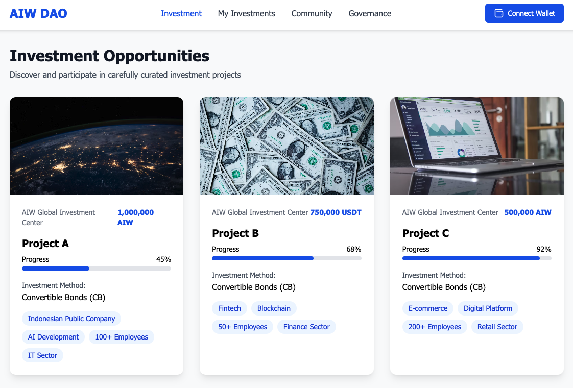
AI WEALTH Project
Web 3.0 based M&A Platform
After the M&A is finalized, public disclosures and other corporate filings may also be included. While the raw data itself is valuable, its interpretation and analysis are equally important due to the complexity of the subject matter.
Accessing and analyzing industry and corporate data is difficult and requires significant time and effort, leading to high costs. As a result, traditional M&A markets rely on intermediaries, such as accounting and consulting firms, despite the transparency issues and misalignment of interests that can arise. To resolve these inefficiencies, the AI-RICCO platform introduces a DAO-based research model and the concept of a specialized M&A Research Agency.
The AI-RICCO M&A Research Agency consists of professional researchers and investors/users of the platform. Researchers are responsible for onboarding and listing selling companies, conducting industry and company analyses, and providing insights to potential investors through DAO mechanisms.
Information provision occurs in three ways: first, sellers can directly update their company information on the platform. Second, professional researchers may conduct independent research and update company data, also acting as brokers. Lastly, users may request specific company research, which is then carried out as needed. Once a company's analysis and verification are complete, it is registered in the DAO Fund, initiating the formal M&A process.
3. M&A DAO Fund
After analyzing and sharing company information, the M&A process moves to its execution phase, where the AI-RICCO platform utilizes a DAO system. Each DAO fund pool lists verified M&A target companies, allowing users to assess company details and decide whether to participate. As a preliminary step, users must sign an NDA (Non-Disclosure Agreement) before entering a pool.
[Example Screen of M&A DAO Fund]

Slide 14
AI WEALTH Project
Web 3.0 based M&A Platform
Companies listed in the DAO Fund must provide key details, including corporate and industry descriptions, revenue figures, target sale price, fundraising method, funding token distribution delay, and percentage of equity being sold. While general information is publicly available, users must sign an NDA to access detailed company data before making a funding decision.
Once the target funding amount is successfully raised, the M&A proceeds to the next stage, where the Research Agency finalizes the process. Upon completion, the DAO determines whether the acquired company issues tokens and gets listed on an exchange. Users who participate in the DAO decision-making process receive rewards based on their voting contributions.
[ M&A DAO System Diagram ]
Blockchain Mainnet
Proposal Template
Proposal Manager
SVM(Solana Virtual Machine)
M&A ICO
Code
Code
Code
Operation
ACL
ACL
ACL
API Service
Access Control List (ACL)
Permission
Role
Core
Script Executor
Proposal
4. M&A Process & Roles
M&A is a highly regulated field due to its significant impact on corporate value. It is governed by multiple laws, including corporate law, capital markets and financial investment law, antitrust law, and tax law. M&A transactions involving public companies are particularly sensitive, as they directly affect stock prices, leading to strict disclosure regulations and limited access to related information. To address this issue, the AI-RICCO platform utilizes AI technology to filter out problematic companies before initiating the M&A process. M&A for public and private companies is handled differently within the platform.

Slide 15
AI WEALTH Project
Web 3.0 based M&A Platform
For public company M&A, detailed company information cannot be disclosed, so only general details such as industry sector and target acquisition amount are available in the DAO FUND. Additionally, general users cannot register public M&A proposals; instead, they must be officially submitted by the platform and its governing foundation through the DAO Proposal system.
Public M&A is managed exclusively through an official DAO, ensuring compliance. Users participate by voting (approve/reject/abstain) on proposals, similar to a DeFi pool mechanism. If a proposal is approved, the tokens used for voting are locked or burned, and upon successful M&A completion, users receive tokens from the acquired company. This distinguishes AI-RICCO from other M&A platforms, with multiple public M&A deals already planned.
[Public M&A Process]
M&A Proposal Registration (Official)
DAO
AI-RICCO Project Team
M&A Proposal
Voting
Lock up
Fund Execution
Investor
Approval
M&A
Token Issuance/Listing
MARKET
New Tokens Distributed to M&A Target Company
For private company M&A, both the platform and general users can register proposals in the DAO FUND, as full transparency of company details is allowed. Users can evaluate registered companies with insights from the Research Agency before deciding whether to participate. Once users enter the DAO FUND, tokens are automatically locked and, after the lock-up period, participants receive tokens from the acquired company.
[Traditional M&A Players/Roles]
DAO Fund Registration (Non-Official)
User / Project Team
DAO
Fund Execution
DAO Fund 참여 / Lock up
M&A
Token Issuance/Listing
MARKET
Investor
New Tokens Distributed to M&A Target Company
B Token Distribution

Slide 16
AI WEALTH Project
Web 3.0 based M&A Platform
In the M&A process, participants can engage through two primary funding options. The first option applies when the target company agrees to a full acquisition or token issuance. In this case, participants invest AIW tokens and receive newly issued tokens from the acquired company. The second option applies when the target company does not issue tokens or when only partial equity is being acquired. Here, participants invest AIW tokens and, after a set period, receive profit-sharing payouts in AIW tokens. In this model, investors receive their initial AIW token investment plus additional AIW tokens based on the company's earnings.
5. AI Program
1. Target Identification : AI automates the process of identifying suitable target companies, improving accuracy and efficiency. By utilizing big data analysis and machine learning algorithms, AI can rapidly assess market trends, company performance, and competitive landscapes to pinpoint ideal acquisition targets.
2. Due Diligence Process : AI enhances due diligence by analyzing vast amounts of data related to business operations, financial health, legal compliance, and regulations, ensuring greater accuracy and completeness in the evaluation process.
3. Simulation & Prediction : AI is used to simulate various scenarios and predict future performance. This helps assess post-M&A synergies and business outcomes, enabling companies to develop strategic plans.
4. Integration & Change Management : After an M&A deal, corporate integration and change management are crucial. AI supports and optimizes these processes by improving human resource management, project timelines, and system integration for seamless operations.
AI-powered M&A solutions play a critical role in helping companies maintain competitiveness and drive growth in rapidly changing market environments. However, since AI-driven M&A is a strategic process, expert consultation and support may still be required.
6. Application of AI-Based Decision-Making Models
1. AI provides decision-making data to guide investment diversification and investment levels.
ex) AI quantifies whether M&A or simple investment is more advantageous for a pre-matched target company.
2. AI analyzes successful and failed M&A cases to predict M&A success rates.
ex) AI evaluates factors like market capitalization, bond issuance, and asset revaluation timing to match companies with high success potential.
3. AI structures investment and acquisition decisions to respond quickly to market needs.
ex) Companies that do not meet key conditions like PMI feasibility are filtered out at the pre-matching stage.

Slide 17
AI WEALTH Project
Web 3.0 based M&A Platform
4. AI learns from M&A-related risks to proactively mitigate threats and ensure a smooth and efficient process.
ex) AI applies automated DD to assess the credibility of financial and operational data, assigning risk scores to manage uncertainties.
5. AI learns from best M&A practices to guide acquiring and target companies toward synergistic outcomes.
ex) AI recommends bolt-on acquisition strategies where public companies acquire their private suppliers to increase corporate value, maintain control, and create market entry barriers for competitors.
7. Multi-Layer Token Economics
AIW token serves as the base currency within the AI-RICCO platform, functioning both as a governance token for key DAO decisions and as a funding mechanism for M&A transactions. Since M&A funding is secured using AIW tokens, ongoing M&A activities and the issuance of subsequent tokens continuously support AIW token value. The token issuance structure is illustrated as follows.
[AIW Token Issuance Layers]
A
Token
Token Issuance
AIW
TOKEN
Lock-up / Vesting Delay
M&A
B
Token
Market Cap Evaluation
C
Token
Buyback / Burn
After M&A funds are secured through the DAO FUND, AIW tokens undergo a lock-up and vesting delay period before being reintroduced to the market. Meanwhile, an equivalent value of newly issued B tokens (representing the acquired company) is generated. As will be further detailed in the Token Economy section, the AIW-driven M&A cycle actively limits AIW token circulation, reducing supply. As M&A transactions continue, this mechanism supports AIW token value growth over time.

Slide 18
AI WEALTH Project
Web 3.0 based M&A Platform
05 | Token Economy
1. Overview
Token Economy
The AIW token functions as the base currency within the AI-RICCO platform, serving both as a governance token and a utility token. As discussed earlier, AIW tokens are used for M&A-related decision-making while also acting as utility tokens, granting membership benefits for services acquired through M&A transactions.
AIW token value is supported through two key mechanisms. First, its value increases as membership benefits and utility use cases expand with ongoing M&A activities. Second, it benefits from governance mechanisms and token-burning processes that limit circulating supply during the M&A process.
Companies acquired through the AI-RICCO platform's governance system will start with digital asset exchanges and later expand into various industries. Additionally, AIW tokens are structured to limit circulation within the DAO-driven M&A funding system, ensuring a continuous burn mechanism, further supporting token value over time.
2. AIW Token Value Support Mechanism/Logic/Structure (Solution-based)
AIW token plays a crucial role in M&A governance and acquisition funding cycles, making it essential to manage the period during which tokens circulate in the market. Ideally, funds raised through the AI-RICCO platform and AIW tokens are converted into newly issued tokens of the acquired company, ensuring a value transfer. However, to maintain token liquidity and the sustainability of the business model, a distribution delay period is required to prevent market oversupply.
This mechanism can be represented as follows.
[Traditional M&A Players/Roles]
AIW Token Vesting
Distribution Delay
Foundation Pool
M&A Round Initiation
Execution Request
Fiat Fund Execution
Fund Pool Reallocation
DAO
ICO Round for M&A
User
Funding / ICO
MARKET
B Token Distribution
Company B
Market Cap Surplus AIW Token Buyback/Burn

Slide 19
AI WEALTH Project
Web 3.0 based M&A Platform
Since M&A operates under traditional legal and financial frameworks, fiat capital must be secured for execution. When an M&A ICO is conducted using AIW tokens, a vesting and distribution delay period is required to regulate market supply. This period serves as a buffer model to stabilize AIW token prices while ensuring a steady supply of fiat capital for ongoing M&A transactions. The duration of this period is determined by DAO governance. Furthermore, once an acquisition is completed and new B tokens are issued, any excess value from the acquired company is used for AIW token buyback and burning. This ensures long-term price stability of AIW tokens while preventing excessive inflation of newly issued M&A tokens.
Another key factor supporting AIW token value is its expanding membership benefits following M&A transactions. As AI-RICCO continues acquiring companies, AIW token utility will increase based on the acquired companies' offerings, further reinforcing its ecosystem.
[AIW Token Platform Governance Participation Layers (Example)]
Level | Participation Scope | Requirement
1 Level | Research Agency, M&A Pool Participation | 1+ AIW Token
2 Level | Target Company Research Agency Initiation | 100+ AIW Tokens
3 Level | M&A Pool Creation | 100,000+ AIW Tokens
4 Level | Platform Fee Policy | 10,000,000+ AIW Tokens
[AIW Token Platform Governance Participation Layers (Example)]
Expansion of Membership Benefits
Buyback/Burning of AIW Tokens from Subsequent M&A Tokens
AIW Token Value Appreciation
M&A
Distribution Delay Period Model
Governance Participation
As shown above, AIW token value is sustained through membership benefits, the distribution delay model, buyback/burning mechanisms, and governance participation, ensuring a stable and expanding ecosystem.

Slide 20
AI WEALTH Project
Web 3.0 based M&A Platform
05 | Token Economy
3. AIW Token Burning Policy
Token Economy
The AIW token burning policy is determined within a 10–20% range of project-generated profits. The exact burn rate is decided through DAO platform voting, where members use their Voting Power to influence the final decision. The process involves purchasing AIW tokens from the market and storing them in a burn wallet. This burn wallet is publicly accessible through the DAO platform, ensuring transparency and predictability for users.
1. Burning Objective
- At the end of each project, 10–20% of investment profits are used to purchase tokens from the market and store them in the AIW burn wallet. This reduces token supply, reinforcing value stability.
2. Burning Schedule
- The burn schedule is disclosed via the DAO platform at the end of each project.
3. Burning Volume
- The burn amount is set within 10–20% of investment profits, varying based on project success and determined by user participation.
4. Decision Criteria
- The burn rate is finalized based on project outcomes, and the final amount is decided by participating users.
This policy plays a crucial role in building user trust, and the effectiveness of the burning mechanism significantly impacts the success and stability of the AIW token ecosystem.

Slide 21
AI WEALTH Project
Web 3.0 based M&A Platform
05 | Token Economy
4. AIW Token Dividend Policy
Token Economy
The AIW RICCO LABS dividend policy leverages innovative investment strategies and technological advantages to provide investors with reliable profit distribution.
1. Dividend Objective
- A portion of the profits generated from direct investments and fund formations in AI and advanced technology-based companies is distributed to project participants as dividends. This ensures that investors can generate continuous returns.
2. Dividend Schedule & Rate
- Dividends are paid upon investment completion. The dividend is based on profits from key investment strategies, including CB (Convertible Bonds), BW (Bond Warrants), and M&A (Mergers & Acquisitions). The dividend rate is transparently disclosed through the DAO platform and adjusted by investor voting.
3. Decision Criteria & Method
- The dividend rate and amount are determined by the success of the project and investment performance. Various investment strategies ensure optimal dividend distribution.
- Participants receive NFT shares proportional to their AIW token investment. At the end of the investment period, the company repurchases NFT shares, and investors receive additional AIW reward tokens based on performance.
The AIW RICCO LABS dividend policy is designed with an intuitive system to ensure that users can easily understand and participate. This approach enhances investor confidence and provides sustainable returns through a transparent and structured distribution model.

Slide 22
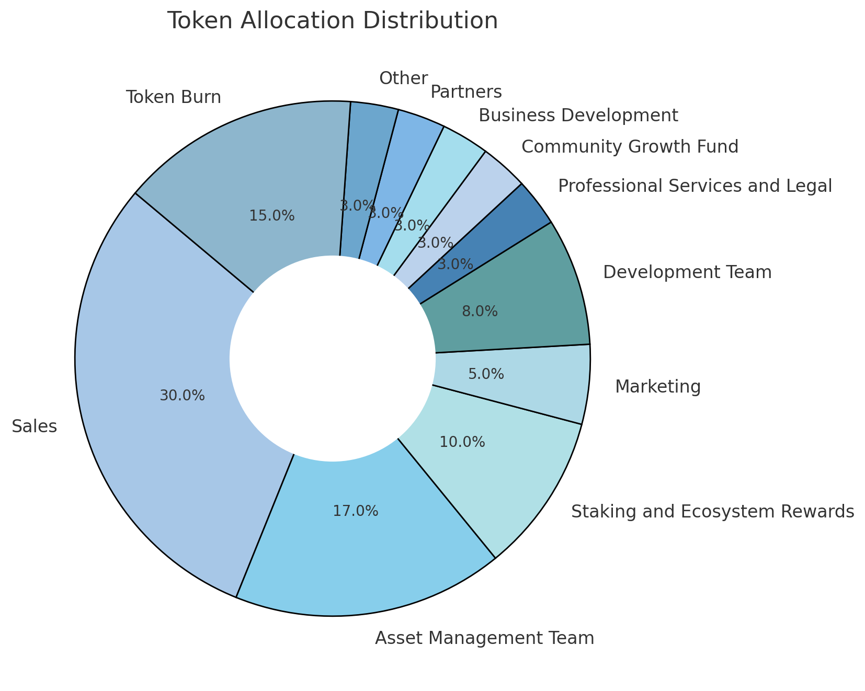
AI WEALTH Project
Web 3.0 based M&A Platform
5. Token Economy
Overview (Supply / Network-Chain)
500,000,000 AIW Token Solana Mainnet
AIW Token Distribution Structure & Explanation
The AIW token distribution model combines blockchain technology with traditional finance to establish a new financial paradigm. Tokens are allocated across various purposes to ensure strategic growth and sustainability.
1. Sales (30%): Secures initial funding and provides liquidity to support strategic investments and user base expansion.
2. Asset Management Team (17%): Allocated to financial product management to enhance AIW’s value through investment strategies and liquidity control.
3. Staking & Ecosystem Rewards (10%): Encourages long-term participation and regulates token circulation to drive ecosystem engagement.
4. Marketing (5%): Supports activities aimed at increasing brand awareness and user acquisition.

Slide 23
AI WEALTH Project
Web 3.0 based M&A Platform
05 | Token Economy
5. Development Team (8%): Invested in platform improvements, blockchain development, and security enhancements.
6. Professional Services & Legal (3%): Covers costs to ensure regulatory compliance and legal stability.
7. Community Growth Fund (3%): Supports community participation and ecosystem expansion.
8. Business Development (3%): Covers essential expenses for global expansion and partnership building.
9. Partners (3%): Strengthens strategic collaborations to support AIW’s ecosystem growth.
10. Others (3%): Reserved for flexible use and contingency funding.
11. Token Burn (15%): Conducted periodically to increase scarcity and reinforce economic stability.
This structure ensures AIW’s long-term growth and economic sustainability, creating a balanced ecosystem that integrates blockchain with real-world financial strategies.
Token Economy

Slide 24
AI WEALTH Project
Web 3.0 based M&A Platform
06 | Roadmap
AIW tokens are secured through the DAO FUND to finance M&A transactions. After an M&A deal is finalized, the tokens undergo a lock-up and vesting period before being redistributed to the market. At the same time, an equivalent value of newly issued tokens from the acquired company (B tokens) is generated. As detailed in the Token Economy section, this M&A-driven AIW token cycle limits token circulation and reduces supply. This mechanism ensures that as more M&A transactions occur, AIW token value continues to appreciate.
Roadmap
2025 Q1
Beta launch of the platform -
Global exchange listing -
2025 Q2
- Implementation of DAO governance
- Launch of NFT Marketplace
- Execution of initial investments in public companies
- Establishment of a specialized investment firm
2025 Q3
Implementation of Staking / DeFi services -
Additional global exchange listings -
2025 Q4
- Further global exchange listings
2026 Q1
Public company M&A transactions -
Implementation of cryptocurrency lending services -
2026 Q2
- Launch of STO services

Slide 25
AI WEALTH Project
Web 3.0 based M&A Platform
07 | Visions
Security Token Offerings (STO) are once again gaining attention. STO refers to the issuance of digital securities on the blockchain, allowing the sale of assets with securities characteristics. In the U.S., STOs have been significantly influenced by the JOBS (Jumpstart Our Business Startups) Act, which aimed to stimulate capital markets and support small, high-growth businesses by facilitating capital formation through digital securities. As STO adoption expands, the model is expected to become more widely integrated into corporate fundraising strategies. With this trend, STOs are projected to gain renewed global attention. Notably, in 2021, the global security token market capitalization grew nearly sixfold in a single year.
Germany-based FINOA, a leading digital asset custody platform, predicts that by 2027, the global security token market will reach a $24 trillion market cap. Tokenized assets will not be limited to stocks, bonds, investment trusts, real estate, and insurance securities, but will also extend to trademarks, patents, and other tokenizable intangible assets.
VISIONS
of M&A Platform
(STO Development)
[Global Security Token (ST) Market Growth Forecast]
(Trillions of USD)
ST Market Cap (Left)
GDP Ratio (Right)
(%)
(Trillions of USD)
15
450
162.7
10
350
10.2
53.5
70.1
250
0.3
9.4
5
150
0
0
In the U.S., STOs utilize various exemptions under the JOBS Act, allowing companies to navigate federal securities laws when issuing security tokens. Issuers must either register with the SEC (Securities and Exchange Commission) or comply with exemption guidelines based on existing securities regulations. If an STO is registered with the SEC, there is no fundraising limit, enabling sales to both institutional and retail investors, along with unrestricted marketing and investment solicitation. However, such offerings must adhere to standard securities disclosure requirements, including financial reporting. This classification means that STO tokens are treated as securities rather than digital assets, reinforcing their regulation under traditional financial frameworks. As the U.S. regulatory model solidifies, it is expected to set a global precedent, influencing regulations in many other countries.
The AI-RICCO platform aligns with this trend, starting with M&A and stock tokenization, ultimately expanding into comprehensive asset tokenization. Its long-term vision includes tokenizing physical assets like real estate and intangible assets such as licenses and copyrights, making them tradable on a blockchain-based platform. In this evolution, the Research Agency and DAO structures will become more functionally integrated, reinforcing a decentralized and transparent financial ecosystem.

Slide 26
AI WEALTH Project
Web 3.0 based M&A Platform
08 | Disclaimer
01 This whitepaper is distributed by AI-RICCO LABS Limited and is intended to provide general information about the AI-RICCO project, as well as details regarding the AIW Token ("AIW Token") at the time of drafting.
02 AI-RICCO LABS Limited, incorporated in Singapore, was established to issue AIW Tokens and develop the AI-RICCO platform services as described in this whitepaper.
03 AIW Token is designed primarily for use within the AI-RICCO project services. The AI-RICCO platform is a project planned and developed by AI-RICCO LABS Limited. The AI-RICCO project, AIW Token, and related platforms are still under development, and the technical and legal aspects may change as development progresses. This whitepaper reflects plans at the time of publication. By purchasing AIW Tokens, users acknowledge and accept this fact, and purchasing decisions are made at their own discretion and responsibility.
04 The AI-RICCO project and AIW Token involve complex structures, requiring continuous improvements and additional services over time. The implementation of these services may take longer than anticipated, and there is no guarantee of completion. AI-RICCO LABS Limited and its affiliates (including employees) do not guarantee any aspect of development, scheduling, or execution. Additionally, the company may establish subsidiaries as necessary to oversee development and operations.
05 To avoid unnecessary disputes and ensure clarity regarding the uncertainties surrounding technical, legal, and financial matters, users must thoroughly understand this whitepaper. Any decisions made based on this document should be made only after consulting appropriate professional advisors. This whitepaper does not constitute a legally binding promise regarding investment, purchase, sale, or any financial transactions. It is not a prospectus, business proposal, or solicitation for investment in any legal jurisdiction, nor should it be interpreted as such. AIW Tokens do not provide rights to investment returns, income, or profits related to the AI-RICCO project. In case of discrepancies between past announcements and this whitepaper, the latest version shall prevail.
06 This whitepaper does not establish any legal obligation regarding the purchase or sale of AIW Tokens. Any contracts related to AIW Token transactions must be executed separately via written agreements (such as private sales, ICOs, or IEO terms on the official website). This whitepaper cannot serve as the sole basis for contractual, investment, purchase, or related financial decisions and should not be legally relied upon.
07 Any contractual agreements between AI-RICCO LABS Limited and token purchasers, including private sales, ICOs, or IEOs, will be governed by separate written agreements. In case of inconsistencies between this whitepaper and such contracts, the contract terms shall take precedence.
08 AI-RICCO LABS Limited provides AIW Tokens for use within the AI-RICCO project. The value of AIW Tokens may drop to zero, and no liquidity or redemption guarantee is provided. AIW Tokens are governance and utility tokens and should not be classified, interpreted, or treated as legal tender, securities, bonds, stocks, or derivatives.
Disclaimer

Slide 27
AI WEALTH Project
Web 3.0 based M&A Platform
09 AI-RICCO LABS Limited and its affiliates (including employees) do not guarantee the value of AIW Tokens or reimburse purchasers for any financial losses. Any monetary, financial, or other losses—including direct or indirect damages, data loss, or any non-financial damages—resulting from reliance on this whitepaper shall not be the liability of AI-RICCO LABS Limited or its affiliates.
10 The information in this whitepaper is based on materials that AI-RICCO LABS Limited and its affiliates (including employees) believe to be reliable at the time of writing. However, accuracy, completeness, and suitability are not guaranteed. The content is subject to future modifications, but AI-RICCO LABS Limited has no obligation to revise, update, or amend this whitepaper. This document is not intended for distribution in jurisdictions where blockchain-related activities, including token sales and transactions, are restricted or prohibited. If you are a citizen or resident of a country where cryptocurrency transactions are illegal, you are not eligible to acquire AIW Tokens.
11 This whitepaper cannot be copied, distributed, or published in jurisdictions where STOs or token issuance methods are regulated or prohibited. By accessing this document, you acknowledge full understanding and acceptance of its contents, including this disclaimer.
12 The information contained in this whitepaper has not been reviewed, inspected, or approved by any regulatory authority in any jurisdiction. In the event of interpretational conflicts, the English version of the whitepaper shall prevail. Furthermore, no part of this document may be copied, distributed, or published without the prior consent of AI-RICCO LABS Limited and its affiliates (including employees), especially in jurisdictions where token issuance is regulated or prohibited.

Slide 28
AI WEALTH Project
Web 3.0 based M&A Platform
09 | References
[1]
[2]
[3]
[4]
[5]
[6]
[7]
[8]
[9]
[10]
[11]
[12]
[13]
[14]
[15]
[16]
[17]
[18]
[19]
[20]
[21]
References
https://www.intralinks.com/blog/2018/12/blockchain-ma-hope-or-hype
http://www.taxtimes.co.kr/mobile/article.html?no=253445
https://www.reuters.com/markets/us/global-ma-volumes-hit-re-cord-high-2021-breach-5-trillion
-first-time-2021-12-31/
https://economictimes.indiatimes.com/news/economy/fi-nance/at-30-3-billion-mergers-and-acquisitions-hit-four-year-high-in-march-quarter/articleshow/9078240 8.cms
https://www.pwc.com/us/en/services/consulting/deals/library/blockchain-ma-deals.html
https://www.insights.sygnum.com/post/digital-nugget-m-a-in-crypto-assets-the-next-trend
https://jurnal.narotama.ac.id/index.php/ijebd/article/view/1121
https://www.kcmi.re.kr/publications/pub_detail_view.php?syear=2019&zcd=002001016&zno=
1496&cno=5338
https://heinonline.org/HOL/LandingPage?handle=hein.journals/ibuslj2021&div=30&id=&page=
http://www.clairfield.com/wp-content/uploads/Blockchain-and-Smart-Contracts-in-MA2019.03.12.
pdf
https://www.linkedin.com/pulse/role-blockchain-cryptocurrencies-ma-marc-suidan-mba-cpa
https://www.pwc.com/us/en/services/consulting/deals/library/blockchain-ma-deals.html
https://www.joongang.co.kr/article/25076664
https://www.ajunews.com/view/20220509111155432
https://www.roedl.com/insights/ma-dialog/2020-10/blockchain-based-business-models-ma-outlook
https://www.intralinks.com/blog/2018/12/blockchain-ma-hope-or-hype
https://academy.moralis.io/blog/how-blockchain-technolo- gy-changes-ma-transactions-the
-disruptive-power-of-smart-contracts?utm_source=blog&utm_medium=post&utm_campaign=
What%2520is%2520Quant%2520Network%2520and%2520the%2520QNT%2520Token %253F
Yahoo Japan, “5年後は市場規模6,500倍!?...無限の可能性を秘めた 「デジタル証券」マ一ケット”,
2022. 3. 6
Quinlan & Associates, “Cracking the Code: The evolution of digital assets to the mainstream”,
2021. 9
Korea Institute of Finance - "Trends in Security Token Offering (STO) Market and U.S. Regulations", 2022. 5. 10
https://www.intellinews.com/emerging-europe-manda-soars-by-55-to-94bn-in-2021-233079/

